Slide 1




Nexara
Series A: $5M
INVESTOR
AI-Powered Workflow Automation
for Mid-Market Companies
PITCH DECK
Contact
Website
Email
investors@nexara.io
www.nexara.io
hello@nexara.io

Slide 2




Nexara
02
PROBLEM & SOLUTION
Mid-market companies (100-1,000 employees) are stuck in a painful gap: enterprise automation tools like UiPath are too expensive and complex, while SMB solutions like Zapier lack the depth needed for real workflow transformation.
THE PROBLEM
OUR SOLUTION
Mid-market teams waste 15+ hours weekly on manual processes. Enterprise tools require 6-month implementations and $500K+ budgets. SMB tools can't handle complex, multi-step workflows across departments.
Nexara delivers AI-native workflow automation purpose-built for mid-market. Deploy in weeks, not months. Affordable pricing that scales. Deep workflow capabilities with AI built in, not bolted on.
90%
15+ HRS
PRIORITIZE
AUTOMATION
WASTED
WEEKLY

Slide 3

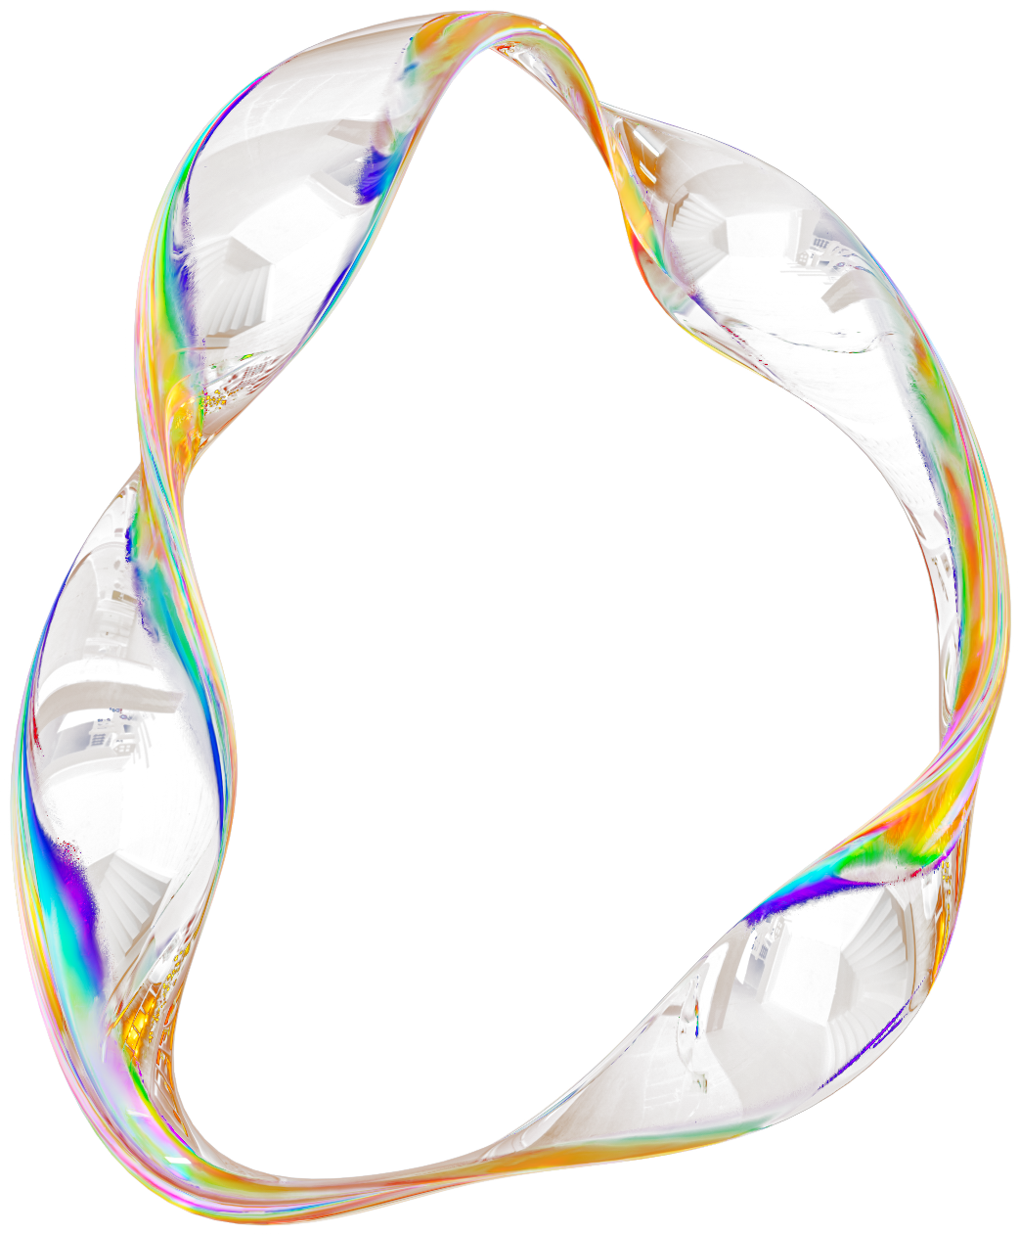


Nexara
03
MARKET OPPORTUNITY
The workflow automation market is experiencing explosive growth, driven by enterprise demand for efficiency. Mid-market companies (100-1,000 employees) remain drastically underserved by current solutions.
$23.77B
$40.77B
9.41%
2025 MARKET
2031 PROJECTED
CAGR
"90% OF LARGE ENTERPRISES LISTED HYPERAUTOMATION AS A STRATEGIC PRIORITY IN 2024-2025."

Slide 4


Nexara
04
COMPETITIVE LANDSCAPE
VS ENTERPRISE PLAYERS
UiPath & Automation Anywhere:
Expensive, slow deployment,
built for large enterprises.
NEXARA POSITIONING
More affordable & faster than
enterprise. Deeper workflows
than lightweight alternatives.
THE NEXARA ADVANTAGE
VS LIGHTWEIGHT TOOLS
AI built-in, not bolted on.
Purpose-built for mid-market.
Zapier & Make: Limited workflow depth, lack enterprise features.

Slide 5
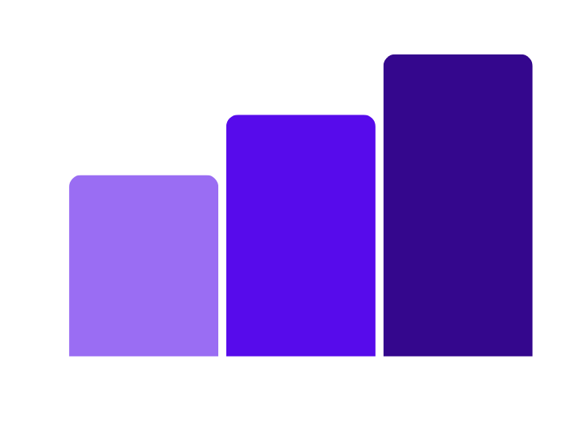
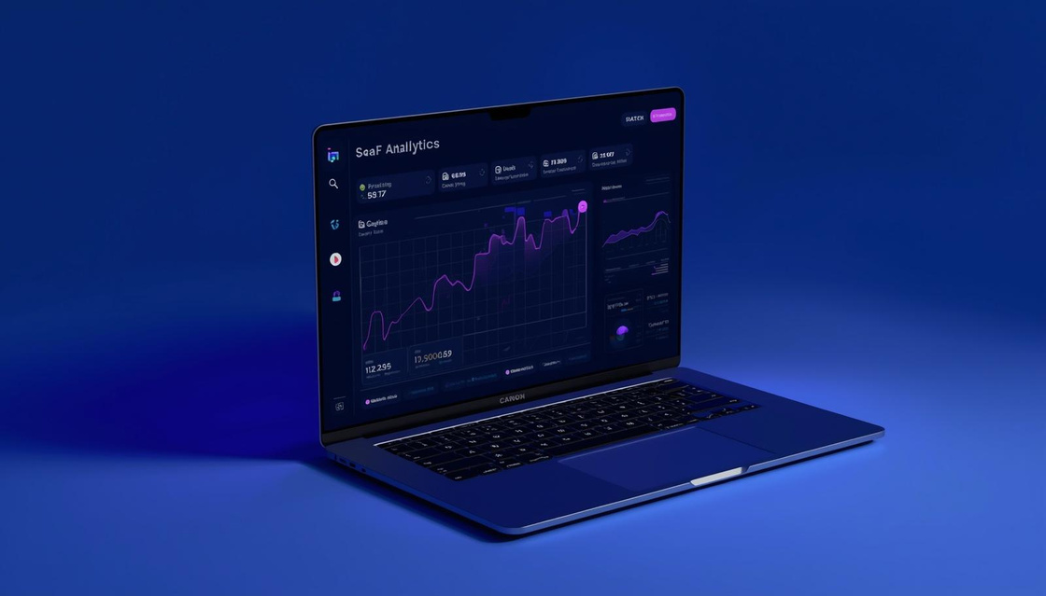
Nexara
05
TRACTION
Q4
Q3
Q2
$89K
$103K
$187K
Revenue
Revenue
Revenue
31
55
94
Customers
Customers
Customers
Q1 2024
Q3-Q4 2024
$42K
12
NPS: 67
Nexara has achieved strong quarter-over-quarter growth, with revenue growing 4.5x from Q1 to Q4. Our customer base expanded from 12 to 94 customers while maintaining best-in-class retention metrics.
REVENUE
CUSTOMERS
CHURN: 4.2%

Slide 6



Nexara
06
BUSINESS MODEL
01
02
03
PER-SEAT SUBSCRIPTIONS
IMPLEMENTATION SERVICES
PREMIUM AI FEATURES
Per-seat SaaS subscriptions starting at $49/user/month for teams of 100-1,000 employees, with volume discounts for enterprise deployments.
White-glove onboarding and custom workflow configuration services, typically 15-20% of first-year contract value.
Advanced AI capabilities including predictive automation and intelligent routing at premium tier pricing.

Slide 7
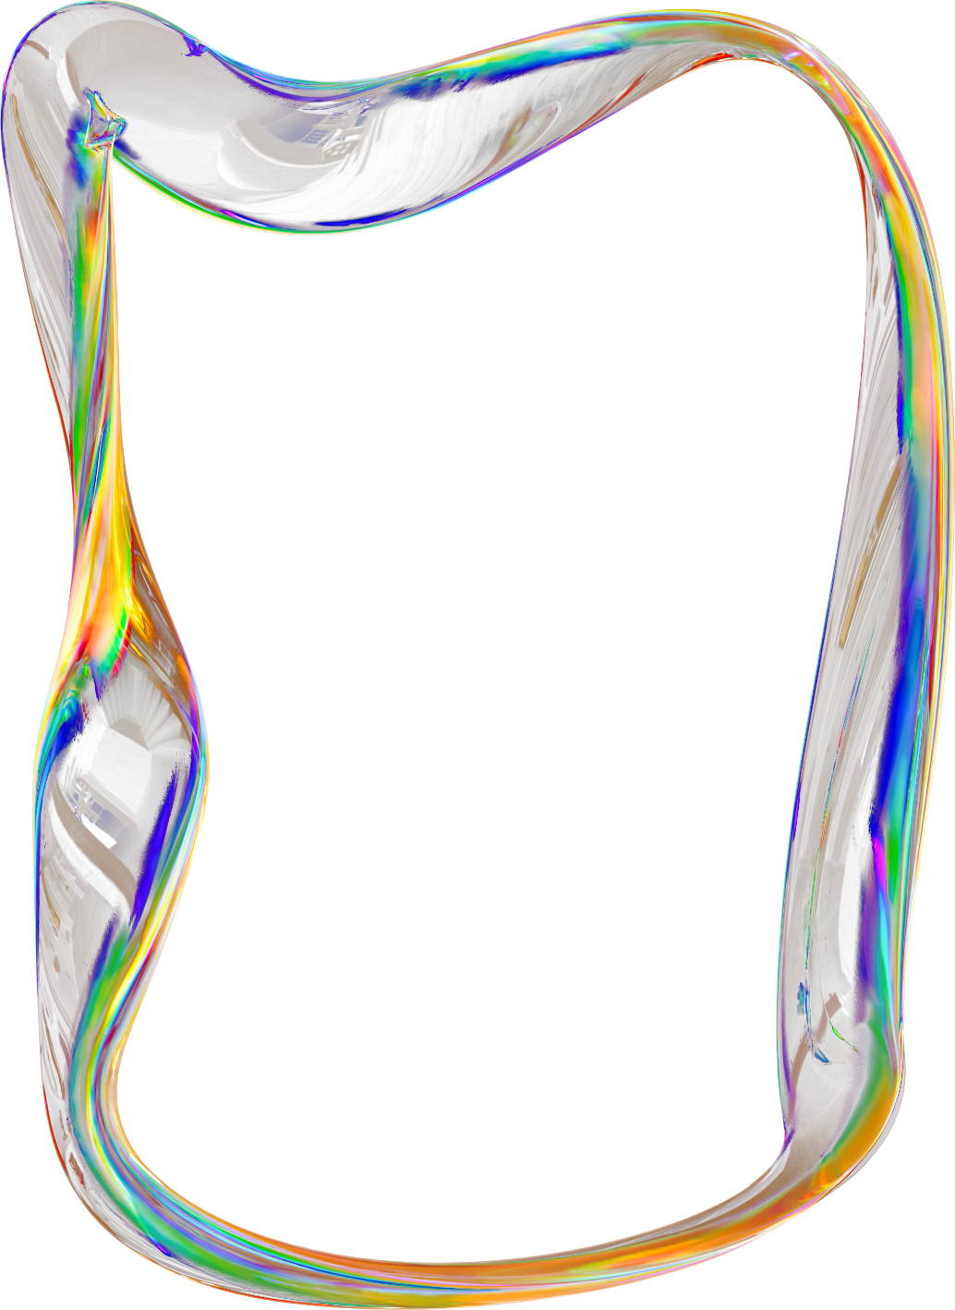

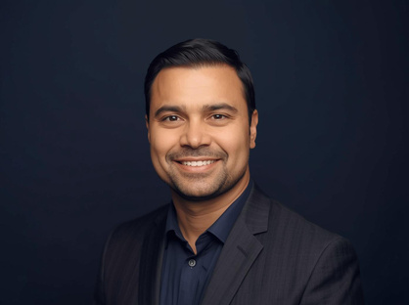


Nexara
07
FOUNDING TEAM
SARAH CHEN
CEO
MARCUS RODRIGUEZ
CTO
JENNIFER PARK
VP Sales
DAVID KIM
VP Product
Former VP Product at Salesforce, 12+ years scaling enterprise SaaS platforms
Ex-Google AI lead, built ML systems processing 1B+ daily requests
15 years B2B SaaS sales, scaled teams at HubSpot and Zendesk from $5M to $50M ARR
Former Director at Workday, expertise in workflow automation and enterprise UX

Slide 8
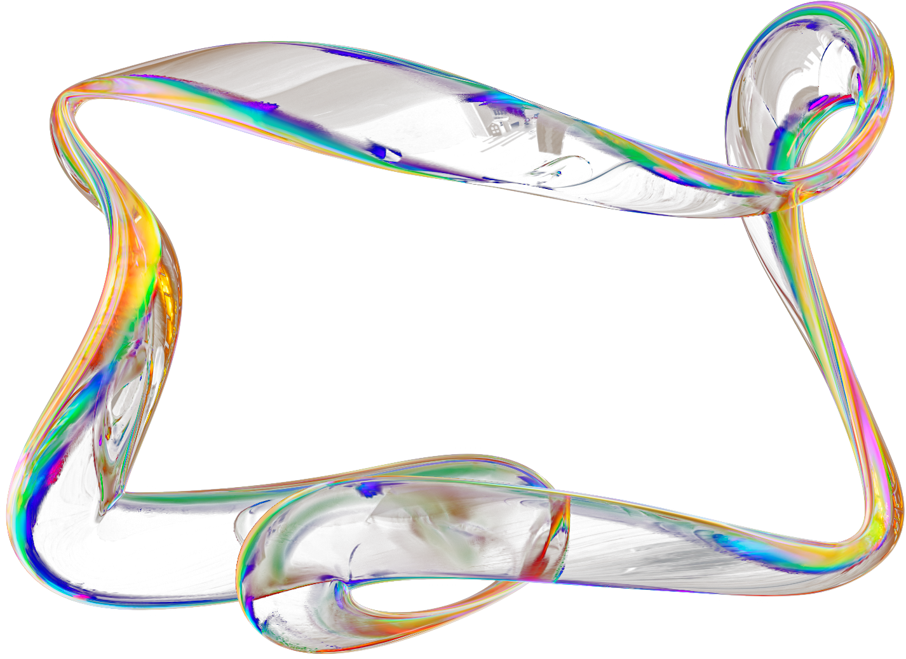

Nexara
08
LET'S
CONNECT
investors@nexara.ai
www.nexara.ai
Schedule a demo call
Raising $5M Series A | AI Workflow Automation

