Slide 1

Nexara
AI-Powered Workflow Automation for the Mid-Market
Raising $5M Seed Round · B2B SaaS · Series A Ready

Slide 2

The Problem — and Our Answer
The Bottleneck
Nexara's Answer
Mid-market companies (100–1,000 employees) lose thousands of hours annually to manual, fragmented workflows — yet they're priced out of enterprise automation tools.
An AI-native workflow automation platform designed for mid-market speed, budget, and complexity — deployed in days, not months.
AI Built In
The Gap
Intelligent process discovery, anomaly detection, and auto-routing — not bolted on as an add-on, but core to the product from day one.
Enterprise platforms like UiPath are too costly and complex. Lightweight tools like Zapier lack the depth for real business processes. No one is built for the middle.

Slide 3
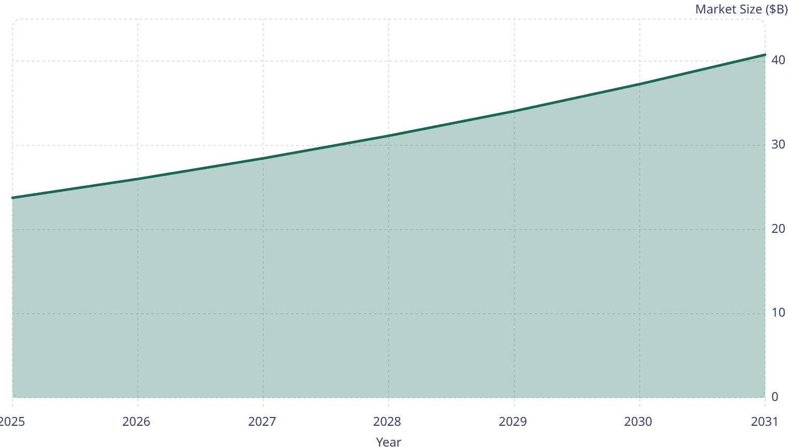

A Market Built for This Moment
Why Now
40.8
37.3
The global workflow automation market is valued at $23.77B in 2025, on track to reach $40.77B by 2031 at a 9.41% CAGR.
34.1
31.1
26
28.5
23.8
90% of large enterprises listed hyperautomation as a top strategic priority in 2024–2025 — and mid-market adoption is accelerating fast.
Nexara's serviceable mid-market segment represents an estimated $6–8B opportunity, largely underserved by current vendors.

Slide 4
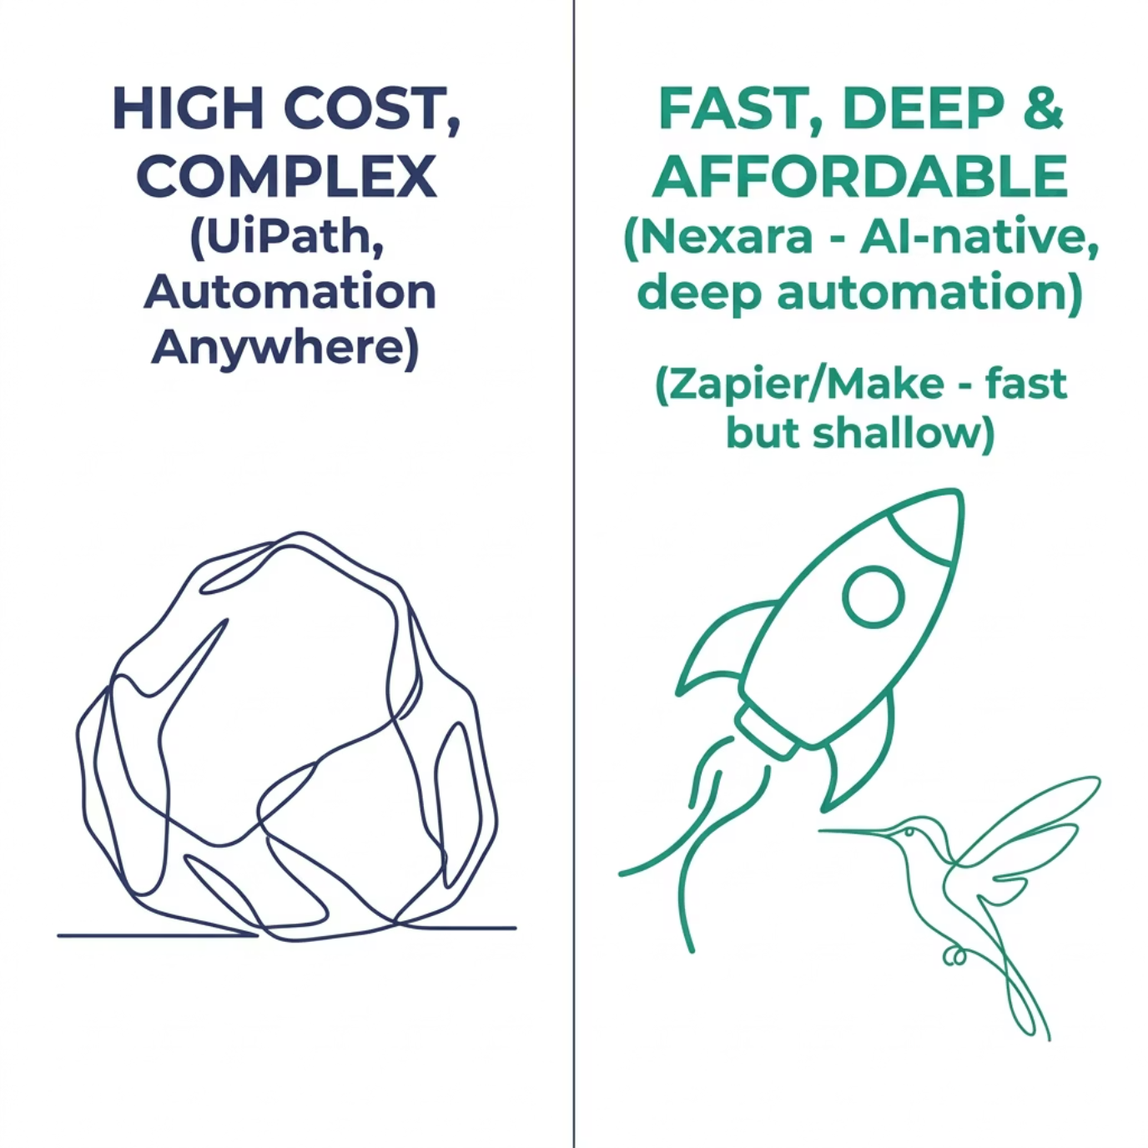


Competitive Landscape
Nexara occupies the white space: enterprise-grade depth at mid-market speed and price — with AI at the core.
vs. UiPath & Automation Anywhere
10x more affordable. Deploy in days, not 6-month implementations.
vs. Zapier & Make
Built for multi-step, logic-heavy enterprise workflows — not just simple triggers.
AI-Native Advantage
Intelligent routing, process discovery, and anomaly detection — embedded, not integrated.

Slide 5
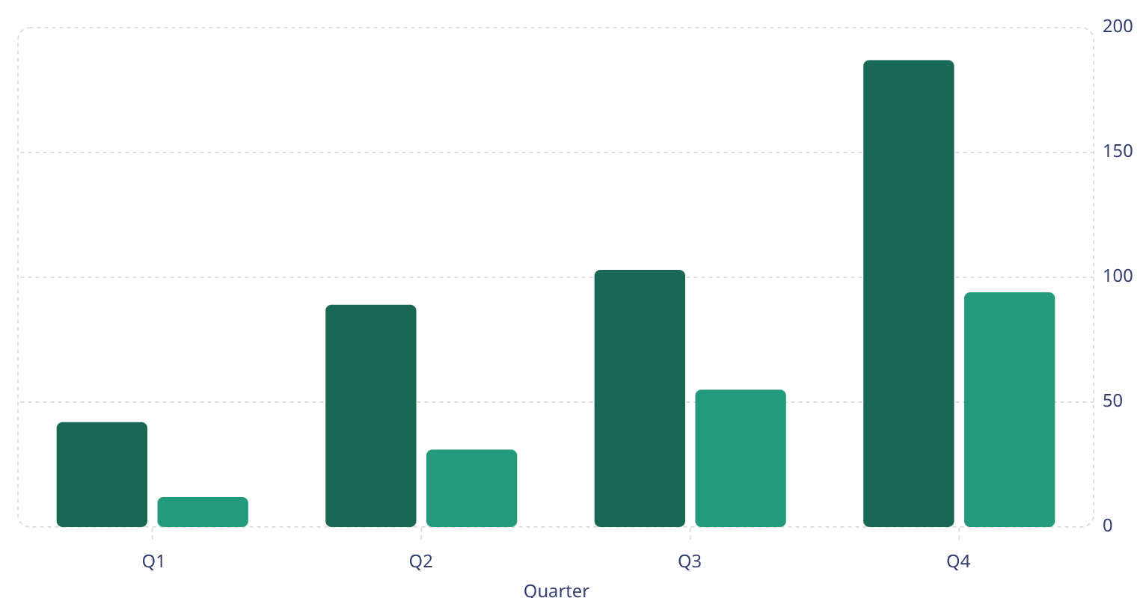
Traction — The Numbers Speak
94
$421K
4.2%
67
Active Customers
ARR Run Rate
Annual Churn
NPS Score
Up from 12 at the start of Q1 — 7.8x growth in 12 months
Q4 monthly revenue of $187K × 12 — accelerating each quarter
Well below the SaaS mid-market benchmark of ~10–12%
World-class. Benchmark for B2B SaaS is 31.
Revenue ($K)
Customers
Growth Trajectory
Revenue grew 345% year-over-year, with Q4 alone representing 44% of full-year revenue — a clear sign of compounding momentum.
187
Customer count grew nearly 8x with churn at only 4.2%, validating both product-market fit and retention quality.
103
94
89
42
55
31
12

Slide 6
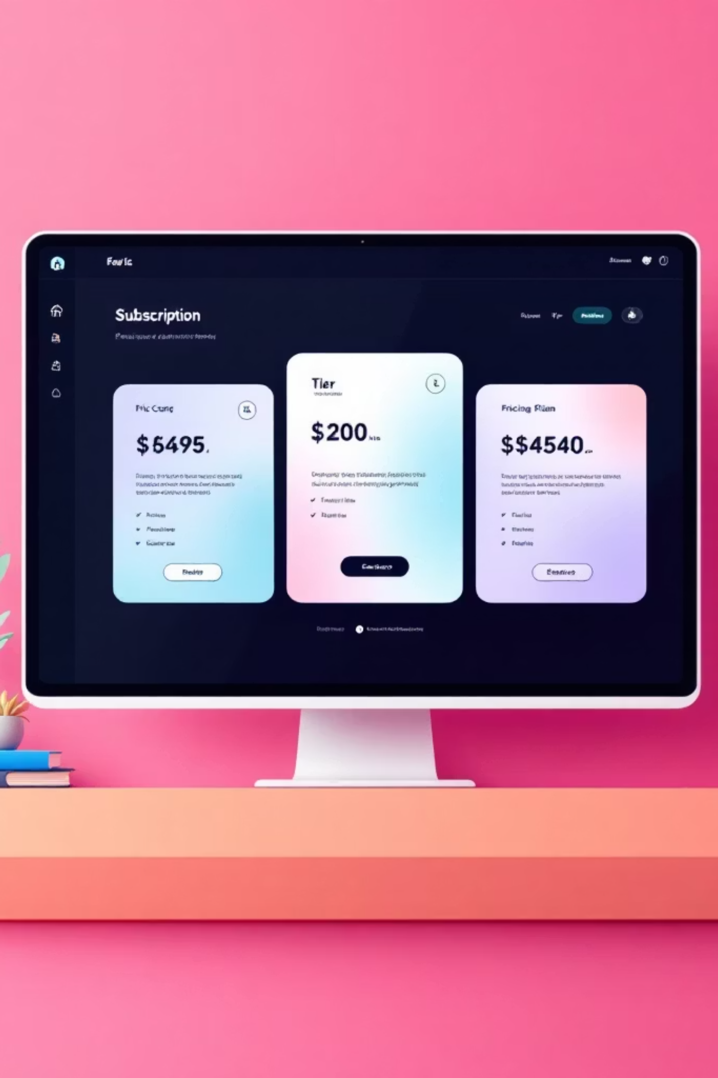
Business Model
Subscription SaaS
Annual contracts. Tiered by seat count and workflow volume. Predictable, recurring revenue.
Pricing
Starting at $499/mo for 10 seats. Mid-tier at $1,499/mo. Enterprise custom pricing above 500 seats.
Expansion Revenue
Land-and-expand motion — upsell on workflows, integrations, and AI credits as usage scales.
CAC & Payback
Current blended CAC ~$1,200. Payback period under 6 months. LTV:CAC trending toward 5:1.

Slide 7





The Team Behind Nexara
A founding team with deep roots in enterprise software, AI, and go-to-market execution.
Alex Morgan
Priya Nair
Jordan Lee
Sara Chen
CEO & Co-Founder
CTO & Co-Founder
VP of Sales
Head of Finance
Former VP of Product at a $500M SaaS company. 10+ years in workflow and enterprise automation.
Ex-Google AI engineer. Built large-scale process automation infrastructure serving 50M+ users.
Scaled two B2B SaaS companies from $0 to $10M ARR. Deep mid-market enterprise rolodex.
Former investment banker and SaaS CFO. Managed capital raises totaling $40M+ across two exits.
Advisors include former executives from Salesforce, ServiceNow, and Workato.

Slide 8


The Ask: $5M Seed Round
Use of Funds
Milestones This Round Unlocks
40% — Product & AI
Reach $2M ARR within 18 months of close
Expand AI capabilities, integrations, and enterprise feature depth.
Grow customer base to 300+ accounts
35% — Sales & Marketing
Launch enterprise tier with SSO, audit logs, and SLA guarantees
Build outbound motion, hire 4 AEs, and invest in demand generation.
Position for Series A at $4–6M ARR in 2026
25% — Operations
Infrastructure, customer success, and 18-month runway buffer.
Let's build the automation layer for the mid-market together. Contact: invest@nexara.io

