Slide 1

NEXARA
AUTOMATE SMARTER. SCALE FASTER.
AI-Powered Workflow Automation for the Mid-Market
Intelligent automation that deploys in days, not months — built for companies that can't afford to wait.
SERIES SEED INVESTOR PITCH
•
2026

Slide 2

Mid-Market Companies Are Stuck Between Tools That Are Too Simple or Too Complex
01
Enterprise platforms are prohibitively expensive and slow — implementations take 6–18 months and require dedicated IT teams, pricing out the mid-market entirely.
ENTERPRISE PLATFORMS
UiPath, Automation Anywhere Too expensive, 6-18mo deployment
02
SMB no-code tools lack depth and reliability — they break under volume, lack AI intelligence, and can't handle complex multi-step workflows.
THE MID-MARKET GAP
03
The result: a $23.77B market with a massive underserved middle. Millions of businesses process thousands of workflows manually, inefficiently, and at scale.
100-1,000 employees Millions of underserved businesses
04
The cost of inaction is compounding: manual processes consume 20–30% of employee time, create bottlenecks, and slow growth.
SMB NO-CODE TOOLS
Zapier, Make Lack depth, break under volume
Strategic Tailwind: 90% of large enterprises have listed hyperautomation as a strategic priority in 2024–2025 (ShareFile / GM Insights) — yet mid-market adoption lags due to lack of accessible solutions.

Slide 3
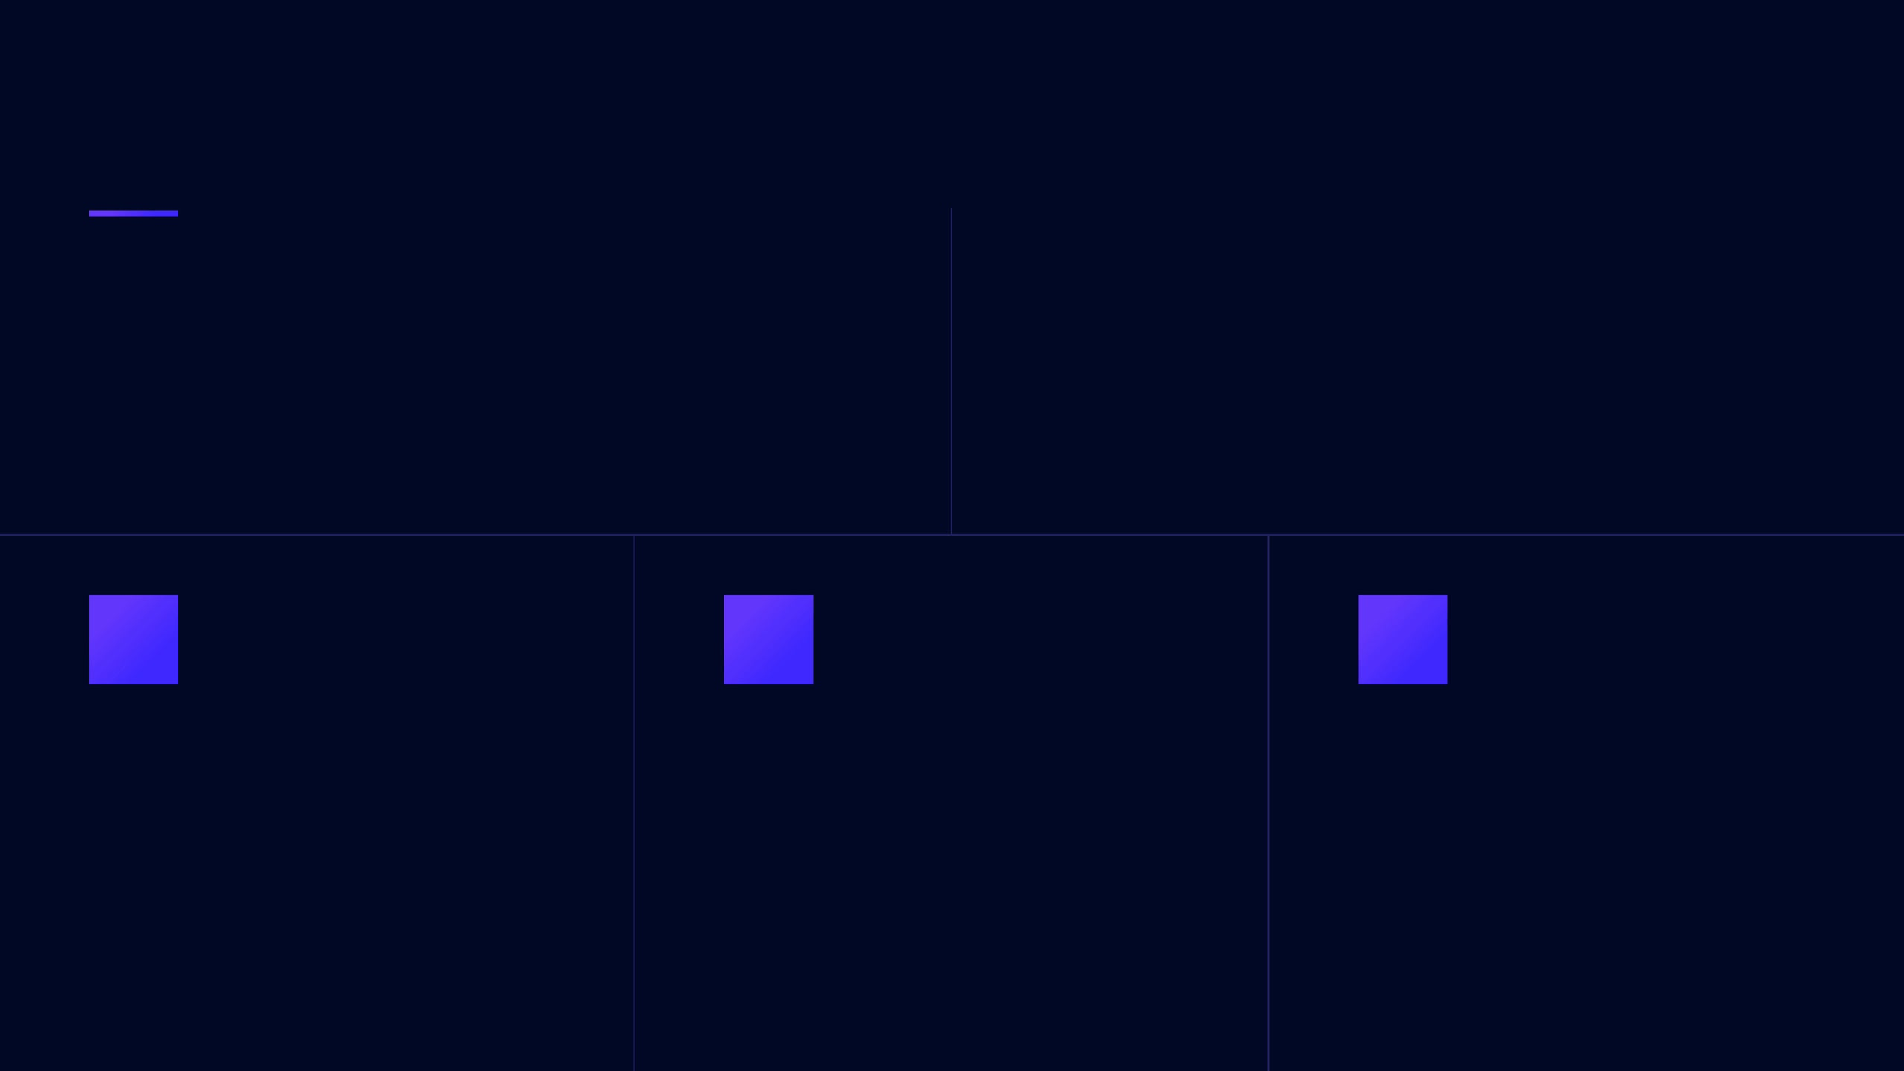



Nexara Closes the Automation Gap — AI-Native, Fast to Deploy, Built for Scale
AI AT THE CORE, NOT BOLTED ON
DEPLOY IN DAYS, PRICED FOR REALITY
Built from the ground up with large language model intelligence — enabling natural language workflow creation, intelligent exception handling, and adaptive process learning.
Customers go live in under 2 weeks with subscription tiers starting at accessible price points. No six-figure implementation fees, no dedicated IT team required. Outcome-focused from day one.
Nexara Flow
Nexara Intelligence
Nexara Connect
Visual drag-and-drop workflow builder with AI suggestions. Empowers operations teams to design complex multi-step processes without writing code.
AI-powered anomaly detection, process optimization, and predictive routing. Learns from exceptions to continuously improve workflow efficiency.
200+ native integrations with enterprise and mid-market SaaS tools (Salesforce, HubSpot, NetSuite, Slack). Seamless data flow across your entire stack.

Slide 4

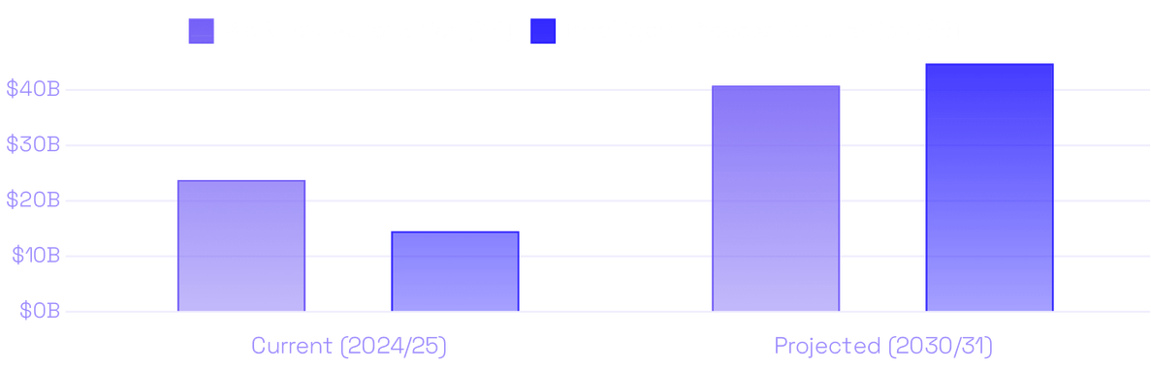
Nexara Targets a $40.77B Workflow Automation Market Growing at 9.41% CAGR
Strategic Tailwind
CORE: WORKFLOW AUTOMATION
ADJACENT: INTELLIGENT PROCESS AUTO.
$40.77B
90% of large enterprises have listed hyperautomation as a strategic priority in 2024–2025. This demand is cascading down to mid-market buyers who need accessible solutions.
$44.74B
Projected by 2031 (from $23.77B in 2025)
Projected by 2030 (from $14.55B in 2024)
9.41% CAGR
Nexara's Addressable Slice
22.6% CAGR
The mid-market segment (100–1,000 employees) represents a significant and structurally underserved portion of this total market — companies with real automation needs but without enterprise budgets.
Timing Advantage
AI-native platforms are displacing legacy RPA tools. The window to capture mid-market customers before incumbents re-price downward is now.

Slide 5

Nexara Is the Only AI-Native Platform Built Specifically for Mid-Market Scale and Speed
CAPABILITY
UIPATH
AUTOMATION ANYWHERE
CELONIS
ZAPIER / MAKE
NEXARA
Target Segment
Enterprise
Enterprise
Enterprise
SMB
Mid-Market
AI-Native Architecture
Partial
Partial
Partial
No
Yes
Deployment Speed
6–18 months
6–12 months
3–9 months
Days
Days–2 weeks
Mid-Market Pricing
No
No
No
Yes (limited)
Yes
Workflow Depth
High
High
High
Low
High
No-Code Builder
Partial
Partial
No
Yes
Yes
VS. ENTERPRISE RPA
VS. PROCESS MINING
VS. SMB NO-CODE
UiPath & Automation Anywhere: Nexara delivers comparable workflow depth at a fraction of the cost and implementation time — no professional services army required.
Celonis: Excels at process mining for large enterprises; Nexara focuses on workflow execution and automation specifically for the mid-market.
Zapier & Make: Nexara handles complex, multi-system enterprise workflows that no-code SMB tools cannot — with AI intelligence embedded throughout.

Slide 6

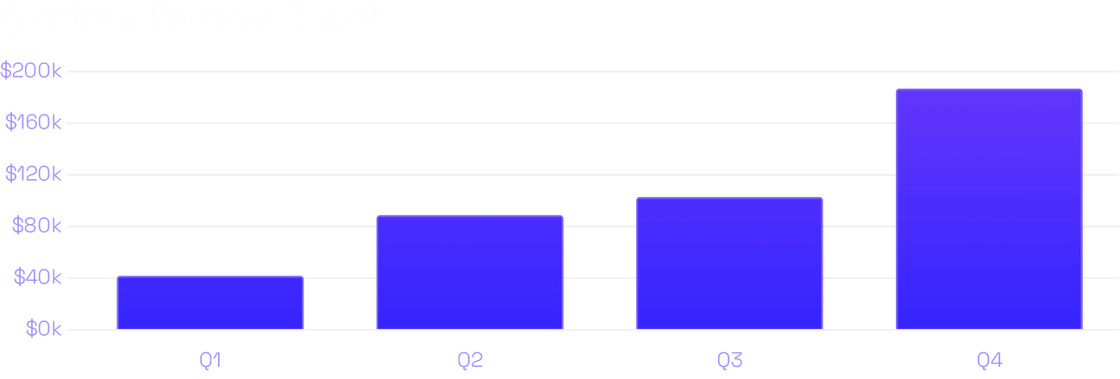
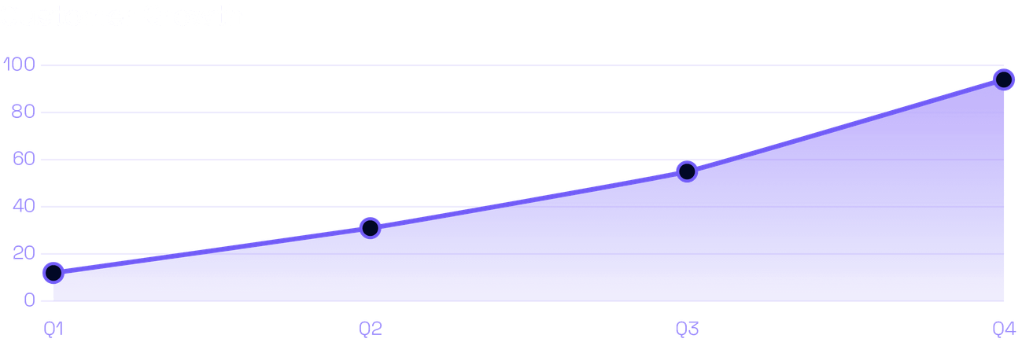
Strong Early Traction: 4× Revenue Growth in 12 Months with Healthy Unit Economics
YEAR 1 FINANCIAL HIGHLIGHTS
Total Year 1 Revenue:
$421,000
Q4 Annualized Run Rate:
~$748,000
Customer Growth (12mo):
12 → 94 (683%)
MONTHLY CHURN
NET PROMOTER SCORE
4.2%
67
Within normal early-stage range (Benchmark: < 5%)
Excellent customer satisfaction (Benchmark: > 50)
GROSS MARGIN
CAC PAYBACK
50-65%
6-12mo
AI-first B2B SaaS profile Improving as infra costs decline
Target payback period Efficiency benchmark for SaaS

Slide 7
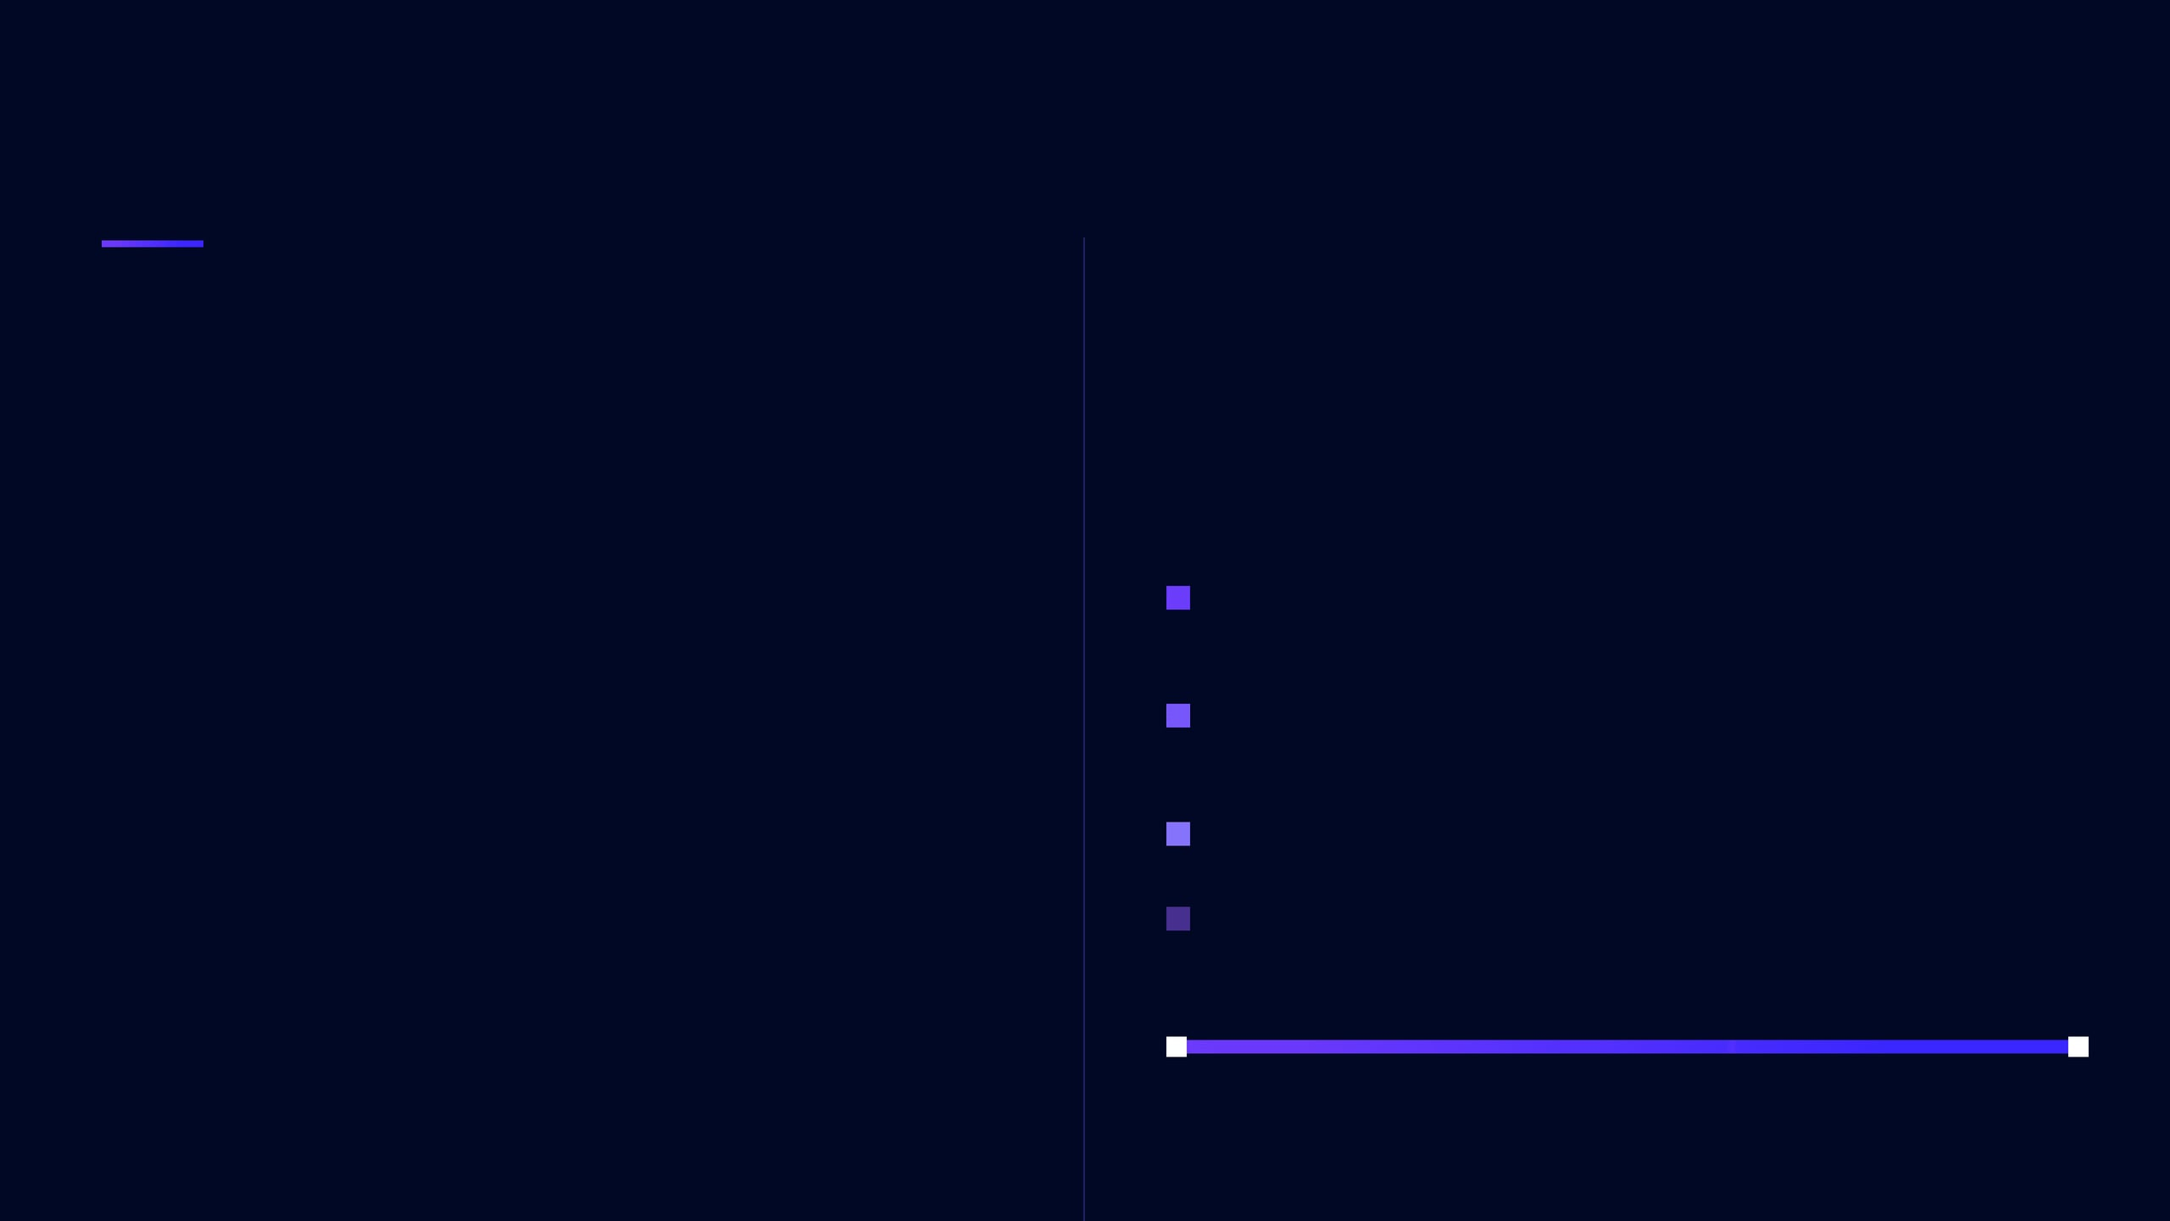

Raising $5M to Accelerate GTM, Deepen AI, and Own the Mid-Market Before the Window Closes
$5,000,000
USE OF FUNDS
SEED ROUND
Comparable Raises: Early-stage B2B SaaS AI companies at similar revenue stages (e.g., TranscendAP, InRev) have raised $3.8M–$5M, validating the size and stage of this ask.
40% — Go-to-Market & Sales
WHY NOW
Expand sales team, invest in demand generation, and accelerate channel partnerships
AI-native platforms are displacing legacy RPA — the mid-market replacement cycle is beginning.
■
35% — Product & Engineering
Deepen AI capabilities, expand integration library to 400+ connectors, build enterprise security
Proven product-market fit: 94 customers, $421K in year-one revenue, NPS of 67.
■
15% — Customer Success
Clear path to Series A: The $5M round provides 18–24 months of runway to reach $3–5M ARR.
Scale onboarding, reduce time-to-value, and protect NPS above 60
■
10% — Operations & G&A
Infrastructure, legal, and team operations
RUNWAY & MILESTONES
Today Seed Round
18–24 Months $3–5M ARR / Series A

Slide 8







Nexara Is Built by Operators with Deep Domain Expertise in Automation, AI, and Mid-Market SaaS
CEO / CO-FOUNDER
CTO / CO-FOUNDER
VP SALES
HEAD OF PRODUCT
Former VP of Operations at a mid-market SaaS company; led automation initiatives saving $2M+ annually.
10+ years in AI/ML engineering; built workflow automation infrastructure at scale; holds patents in process optimization.
Proven B2B SaaS sales leader with experience closing mid-market deals at companies like HubSpot and Salesloft.
Former product lead at an enterprise automation platform; understands the balance of enterprise depth and mid-market simplicity.
\"
Every mid-market company deserves the same automation power as the Fortune 500 — without the Fortune 500 price tag or timeline. Nexara is building the platform that makes that possible.
JOIN OUR $5M SEED ROUND
invest@nexara.ai
nexara.ai

