Slide 1
NEXARA
AI-Powered Workflow Automation for the Mid-Market
Series A Investment Opportunity

Slide 2
Market Opportunity
Global Workflow Automation
Intelligent Process Automation
$23.77B
$14.55B
→ $40.77B by 2031
→ $44.74B by 2030
CAGR: 9.41%
CAGR: 22.6%
Source: Mordor Intelligence
Source: Grand View Research
90% of large enterprises have listed hyperautomation as a strategic priority in 2024–2025
Source: ShareFile / GM Insights

Slide 3
The Problem
Mid-market companies (100–1,000 employees) are caught in the automation gap:
1
Enterprise solutions are too complex & expensive
UiPath and Automation Anywhere require lengthy implementations and dedicated teams
2
SMB tools lack workflow depth
Zapier and Make can't handle complex, multi-step business processes
3
AI is bolted on, not built in
Legacy automation platforms treat AI as an afterthought, limiting intelligence capabilities

Slide 4
Our Solution
Nexara: AI-Native Workflow Automation
Built from the ground up with artificial intelligence at its core, designed specifically for mid-market companies.
⚡
🧠
💰
🔗
Rapid Deployment
AI-First Architecture
Mid-Market Pricing
Deep Workflows
Go live in days, not months
Intelligent automation that learns
Enterprise power, SMB cost
Complex process automation

Slide 5
Competitive Landscape
 | UiPath | Auto. Anywhere | Celonis | Zapier/Make | NEXARA
Target | Enterprise | Enterprise | Enterprise | SMB | Mid-Market
Complexity | High | High | High | Low | Optimized
AI Core | Bolt-on | Bolt-on | Process Mining | Limited | Native
Deployment | Months | Months | Months | Minutes | Days
Pricing | $$$$ | $$$$ | $$$$ | $ | $$

Slide 6
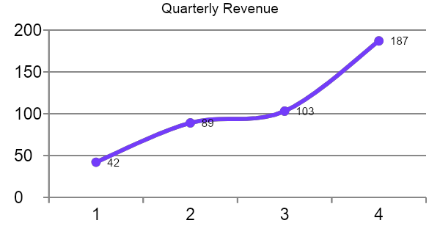
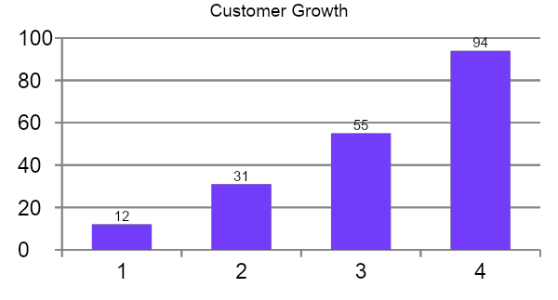
Traction
NPS Score
Monthly Churn
Q4 Revenue
Customers
67
4.2%
$187K
94
Excellent (>50)
Healthy (<5%)
+345% from Q1
From 12 in Q1

Slide 7
Business Model & Benchmarks
SaaS Gross Margins
Healthy B2B SaaS Metrics
NPS > 50 — Excellent (Nexara: 67)
AI-first B2B SaaS typically achieve
50–65%
Churn < 5% — Normal range (Nexara: 4.2%)
Improving as infrastructure costs decline
Source: Monetizely / Bessemer
CAC Payback 6–12 mo — Signals efficiency

Slide 8
Funding Ask
Raising
$5M
Series A
Product Development
Sales & Marketing
Team Expansion
40%
35%
25%
Comparable early-stage B2B SaaS AI rounds (e.g., TranscendAP, InRev) have raised $3.8M–$5M at similar revenue stages

