Slide 1
Nexara — AI‑Powered Workflow Automation for the Mid‑Market
Accelerating operational efficiency for companies with 100–1,000 employees

Slide 2
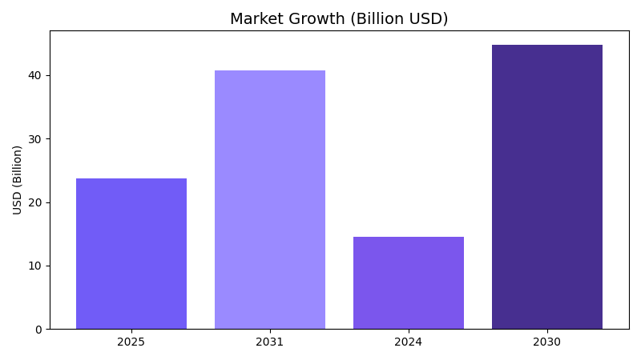
A Massive and Rapidly Expanding Automation Market

Slide 3
Mid‑Market Companies Are Stuck Between Two Extremes
Enterprise RPA platforms are too expensive and slow to deploy
SMB automation tools lack workflow depth and governance
AI capabilities are often bolted on, not native
Result: fragmented processes and rising operational costs

Slide 4
AI‑Native Workflow Automation Built for the Mid‑Market
End‑to‑end workflow automation with AI at the core
Deployable in days, not months
More affordable than enterprise RPA
Deeper workflow logic than Zapier/Make
Real‑time process intelligence and optimization

Slide 5
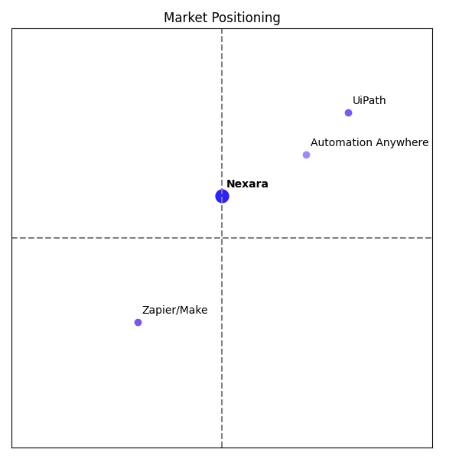
Positioned Between Enterprise RPA and SMB No‑Code Tools

Slide 6
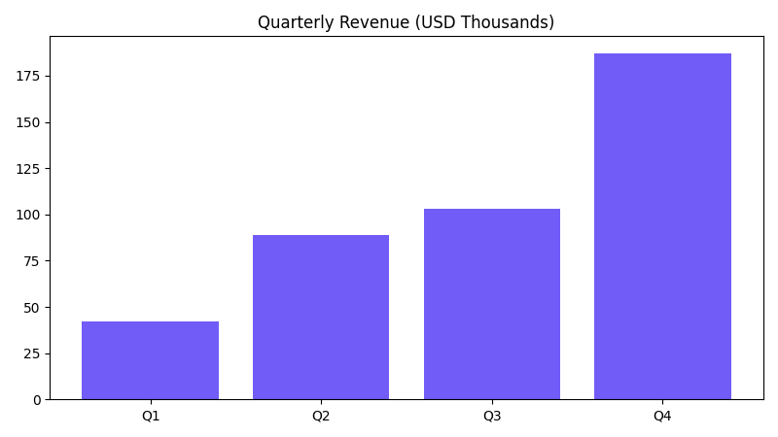
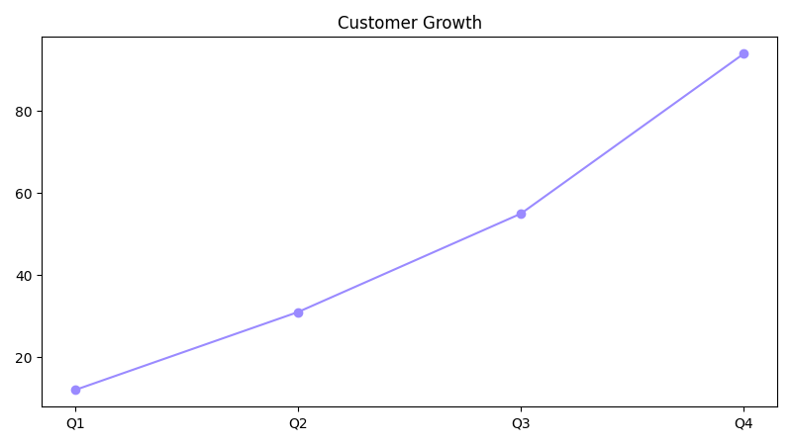
Strong Early Momentum

Slide 7
SaaS Economics with AI‑Driven Margins
AI‑first B2B SaaS companies typically achieve 50–65% gross margins (Monetizely / Bessemer)
Subscription + usage‑based AI workflows
CAC payback target: 6–12 months
High retention due to workflow stickiness

Slide 8
Raising $5M to Accelerate Growth
Expand AI workflow engine
Grow sales & customer success
Strengthen integrations ecosystem
Comparable early‑stage AI SaaS companies (TranscendAP, InRev) raised $3.8M–$5M at similar revenue stages.
Join us in shaping the future of AI‑powered automation.

