Slide 1


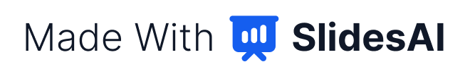
Nexara: Automating the Mid-Market
AI-Powered Workflow Automation for the Mid-Market
Nexara is redefining how mid-sized enterprises orchestrate their business processes. By embedding AI at the core of the workflow engine, we enable companies to automate complex operations without the legacy overhead of traditional RPA.
THE MISSION
THE OPPORTUNITY
TARGET SEGMENT
Empowering mid-market firms to achieve hyperautomation.
Raising a $5M Seed Round to accelerate market penetration.
Companies with 100–1,000 employees seeking enterprise-grade depth.

Slide 2

The Automation Gap for Mid-Sized Firms
The "Platform Mismatch" Crisis
Mid-market companies are currently trapped between two extremes that fail to meet their operational and budgetary needs. This structural gap creates a significant friction point for firms attempting to scale their digital transformation efforts.
Segment | Platform Type | The Failure for Mid-Market
Enterprise | UiPath / Automation Anywhere | Prohibitive TCO (€80k–€200k/year), slow deployment, and heavy CoE requirements.
SMB / SaaS | Zapier / Make | Lacks workflow depth, native AI logic, and the governance required for regulated operations.
The Nexara Solution
Nexara provides the "Goldilocks" alternative: the orchestration depth of enterprise suites with the deployment speed and cost-efficiency of modern SaaS. We offer AI-native design—built-in, not bolted-on—ensuring automation is context-aware from day one.

Slide 3
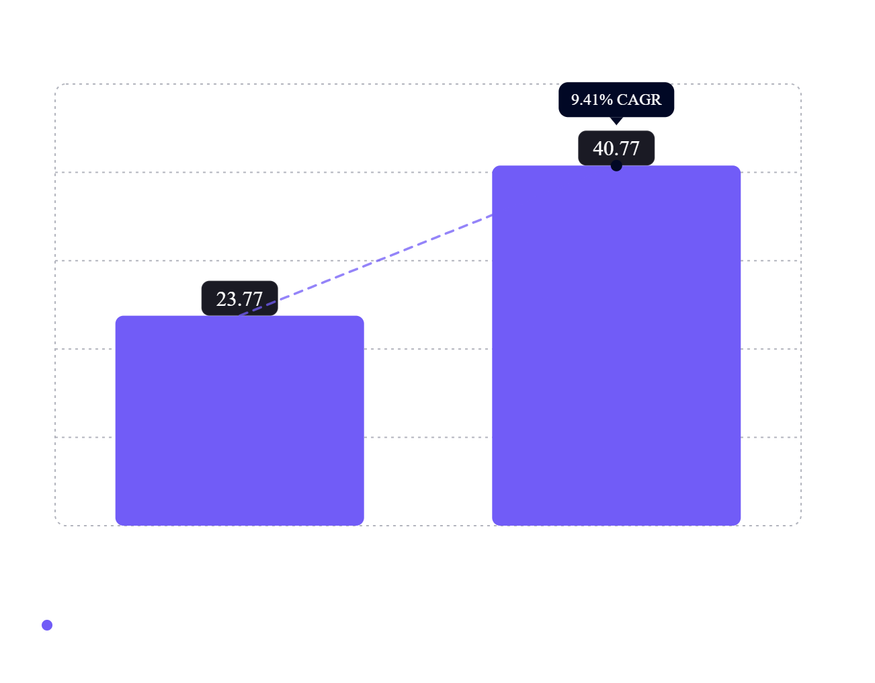
A Multi-Billion Dollar Market Shift
Hyperautomation as a Strategic Necessity
The shift from rule-based scripting to AI-orchestrated ecosystems is accelerating. As organizations outgrow basic tools, they are seeking platforms that offer built-in audit trails and hybrid-cloud flexibility.
Market Momentum: Projected to reach $40.77B by 2031.
Strategic Priority: 90% of large enterprises identified hyperautomation as a top-tier priority.
SME Growth: The small-to-mid enterprise segment is outperforming with a 10.19% CAGR.

Slide 4
The Mid-Market Alternative to Legacy RPA
Vs. Enterprise Incumbents
Vs. Integration Tools
Faster time-to-value and significantly lower TCO. We eliminate the need for specialized developer headcounts.
Superior workflow depth and governance. Supports complex, multi-step business logic and native AI agents.
The AI-Native Advantage
Nexara’s architecture embeds AI-native decision support directly into the orchestration layer for context-aware automation.

Slide 5
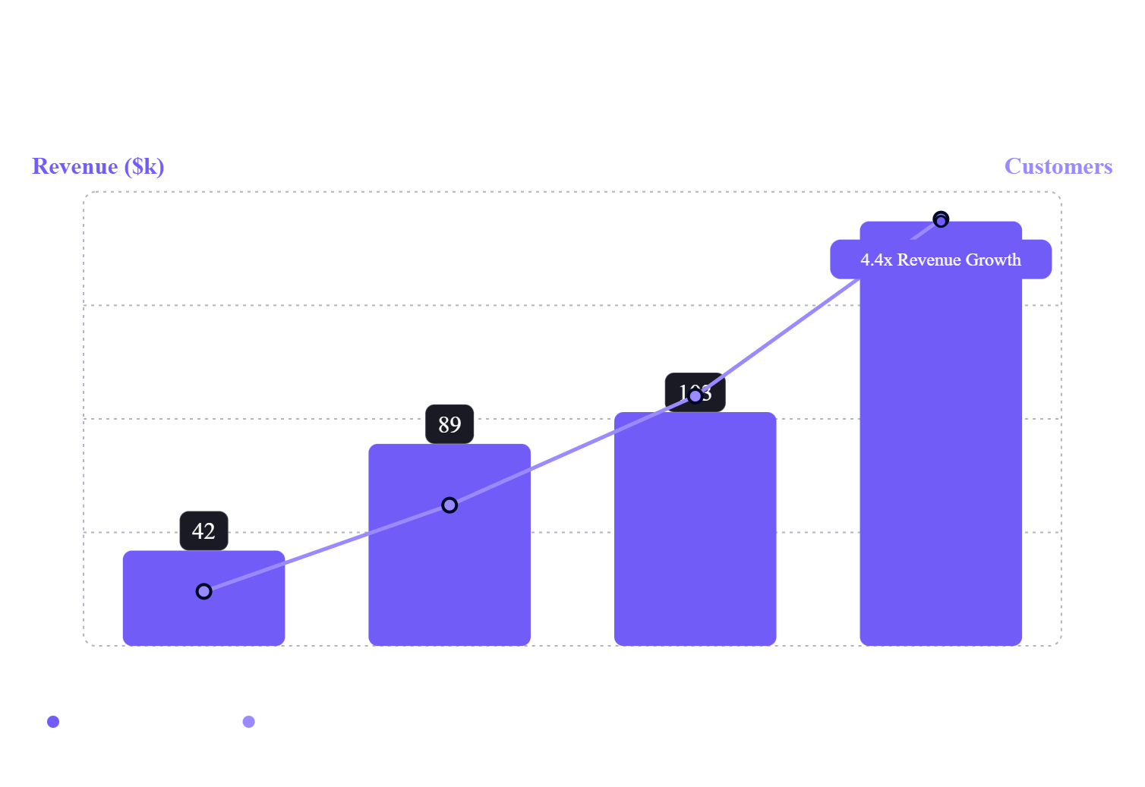
Explosive Growth and Retention Metrics
Validating Product-Market Fit
Our performance demonstrates robust demand and high user satisfaction within our target segment.
4.2%
CHURN RATE
67
NET PROMOTER SCORE
94
TOTAL CUSTOMERS

Slide 6



Scalable SaaS Unit Economics
A Model Built for Mid-Market Scale
High-Margin Architecture
Faster Deployment
Centralized Governance
Agile implementation cycles mean customers see ROI in weeks, not months, accelerating the land-and-expand motion across the enterprise.
Built-in audit trails and data-loss prevention (DLP) provide the structural integrity required for regulated mid-market operations.
Our AI-native engine reduces the human-in-the-loop requirements for deployment, leading to higher gross margins than service-heavy legacy competitors.

Slide 7




Leadership and Technical Expertise
The Team Behind Nexara
Founding Vision
Technical Depth
Execution Capability
AI-Agentic Architecture Experts
Engineering Leadership
Growth & Operations
Experts with backgrounds in business process management and AI-agentic systems.
Experience building scalable, high-governance platforms for regulated industries.
Demonstrated ability to scale revenue 4.4x and acquire nearly 100 customers in year one.
Combining deep domain expertise in AI with a proven track record in enterprise software orchestration.

Slide 8

Seed Round Investment Opportunity
$5M Seed Round
We are seeking $5M in capital to solidify our position as the leading mid-market automation platform.
1. Product Development
2. Go-To-Market
3. Customer Success
Accelerate the roadmap for AI-native agentic features and hybrid-cloud orchestration.
Scale sales and marketing efforts to penetrate the 100–1,000 employee segment aggressively.
Expand infrastructure to maintain our 67 NPS and 4.2% churn rate as we scale.
!
The Roadmap to Series A
Goal: Reach $5M+ ARR run rate as the definitive "Goldilocks" solution.

